Slide 1
CS 347 Project
Milan Kodali & Daniel Pellicone

Slide 2
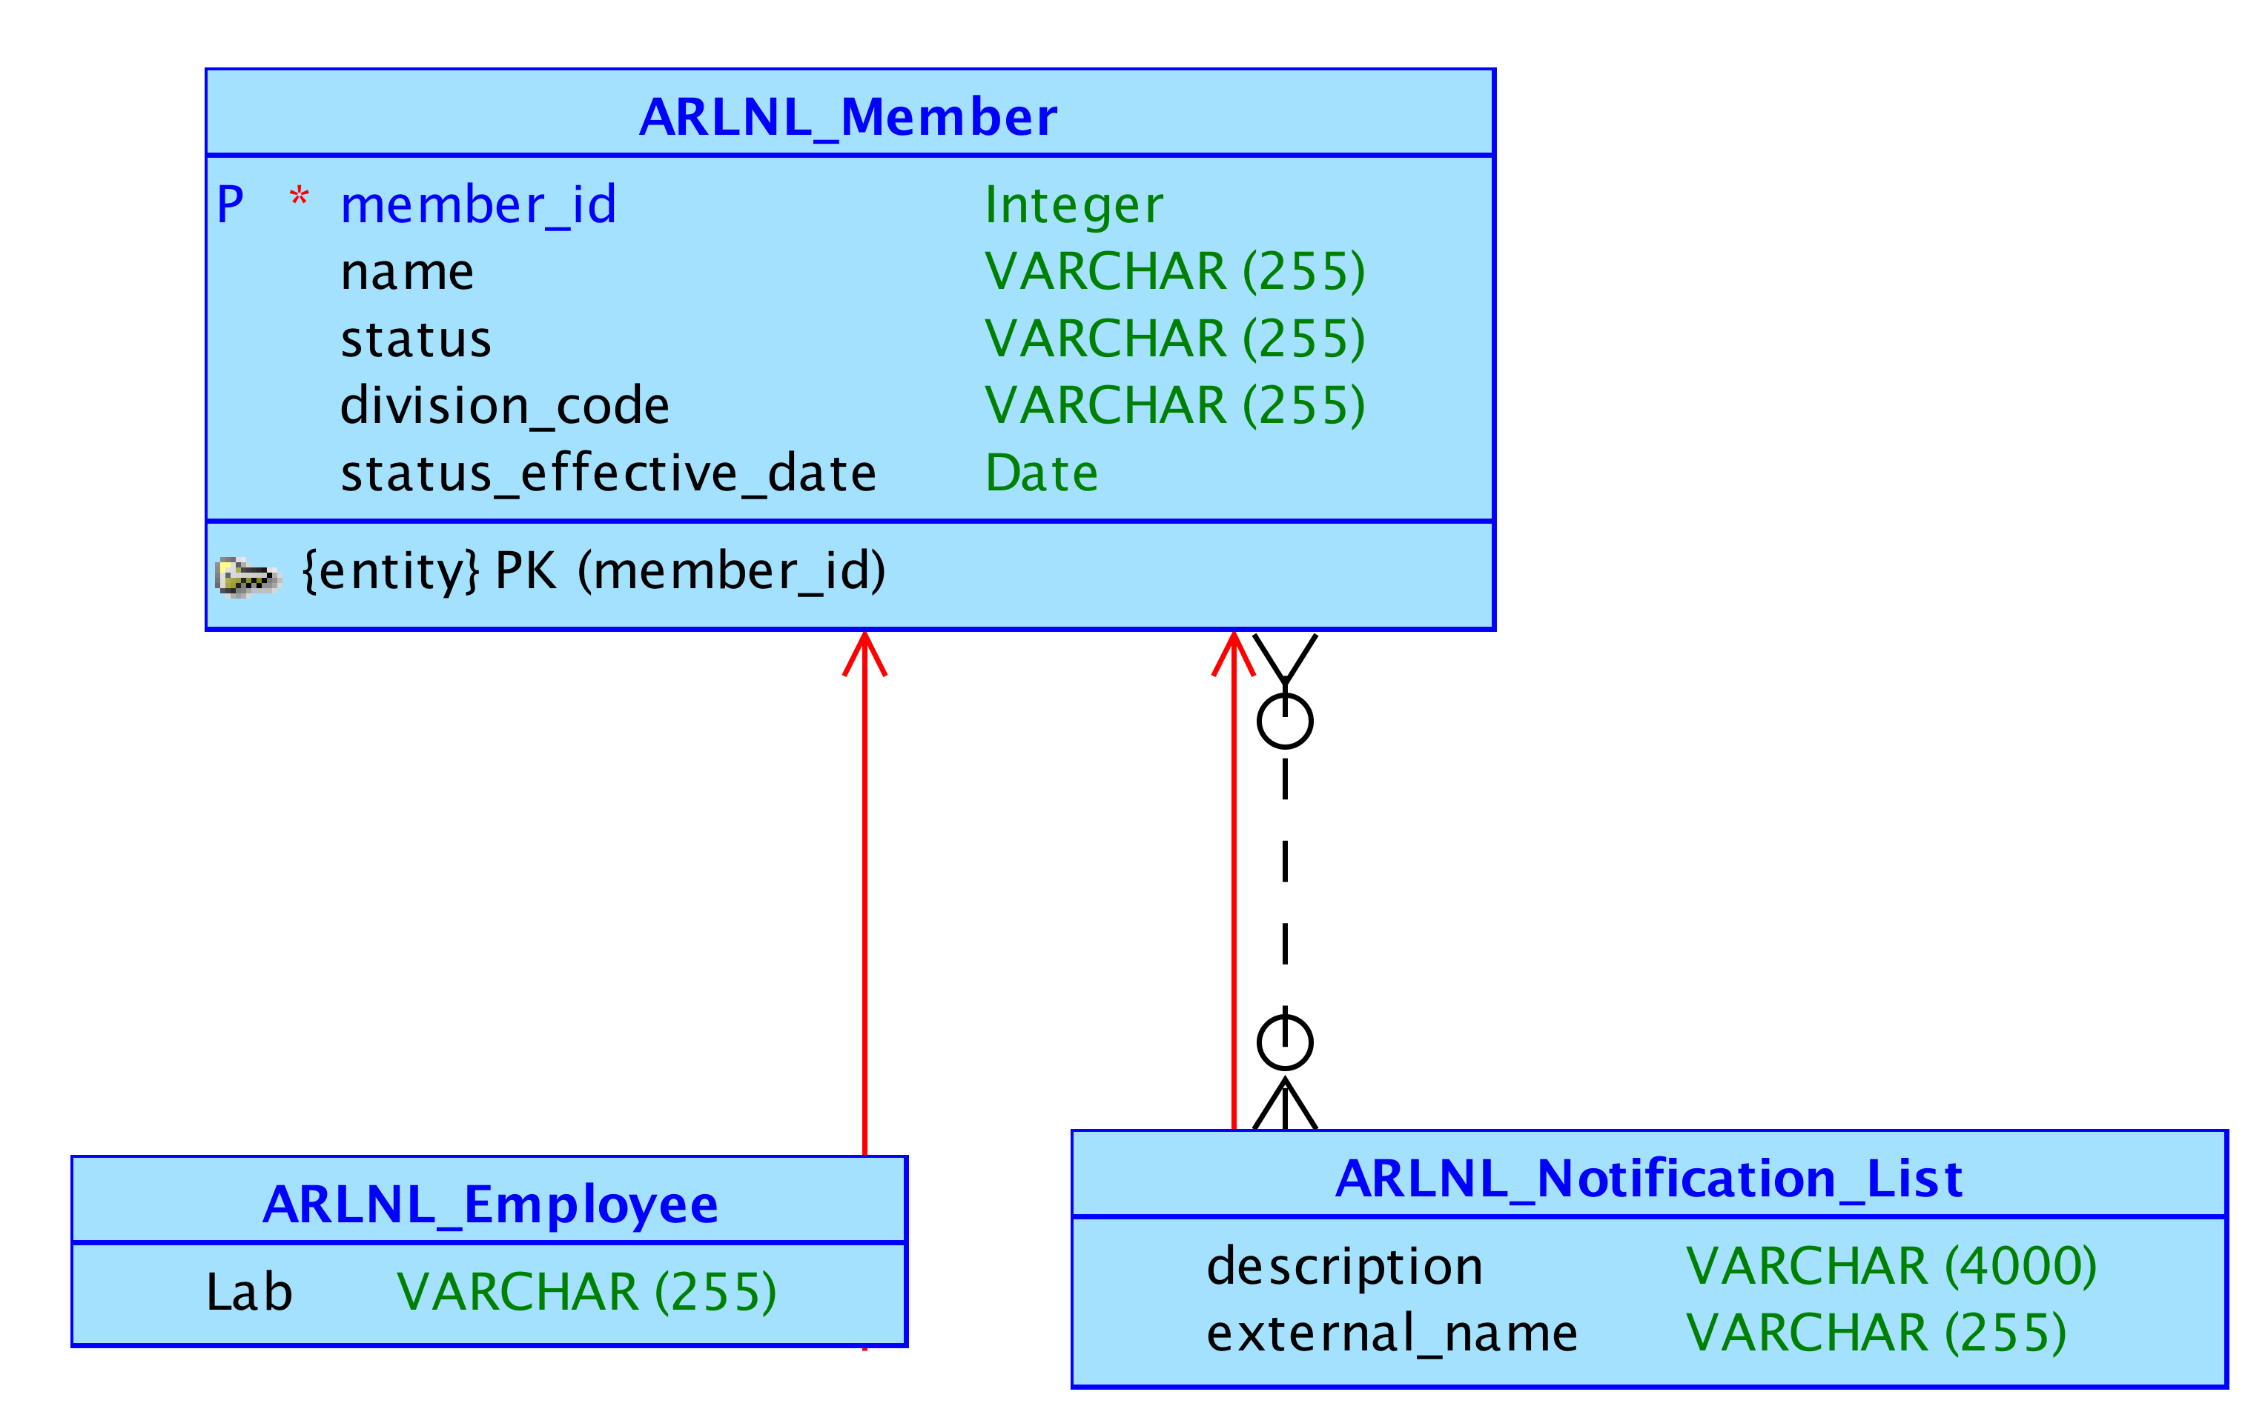
Conceptual Model

Slide 3
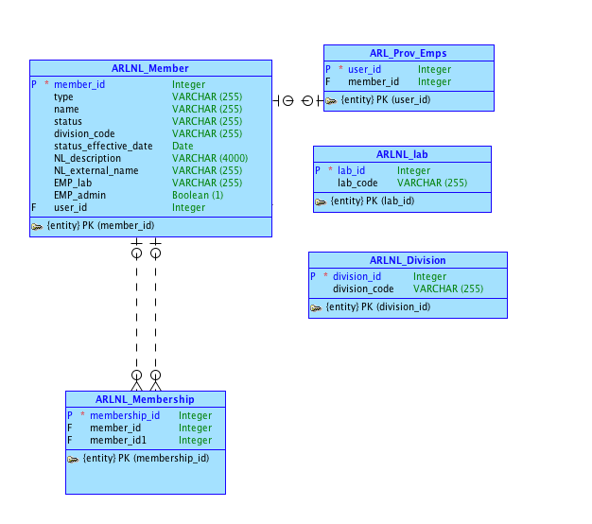
Logical Model

Slide 4
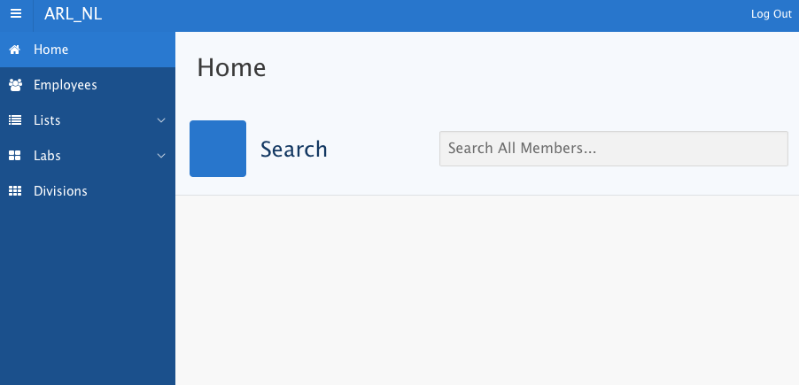
Home Page

Slide 5
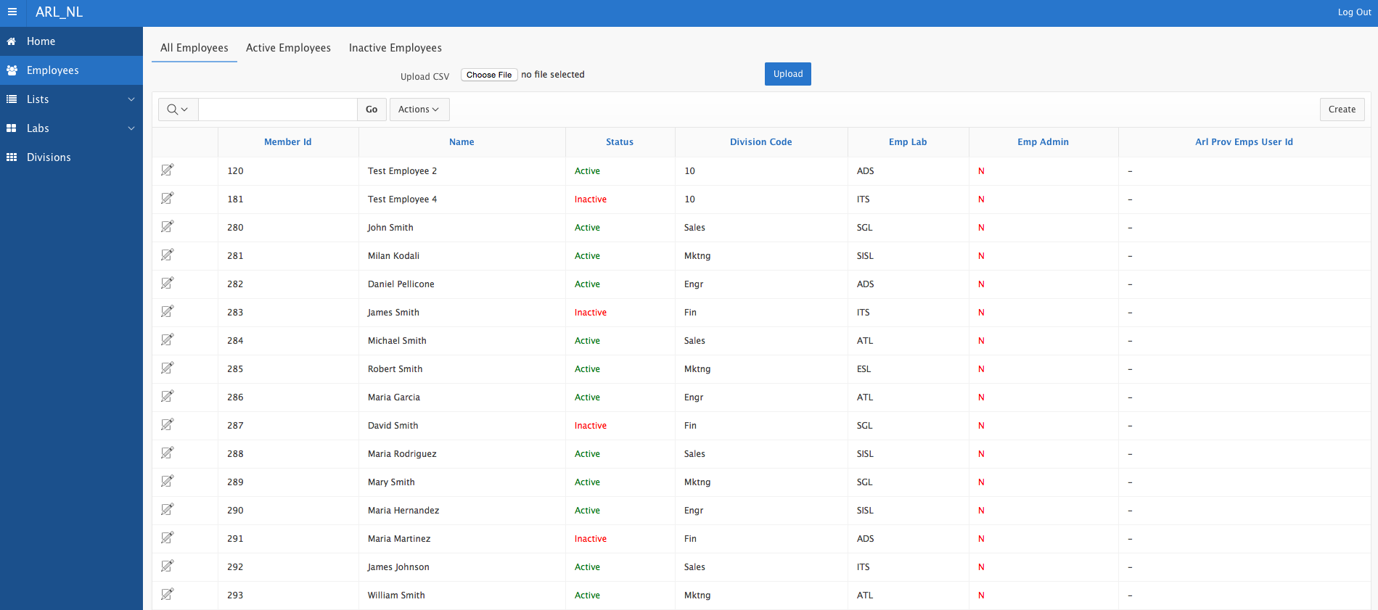
Employees

Slide 6
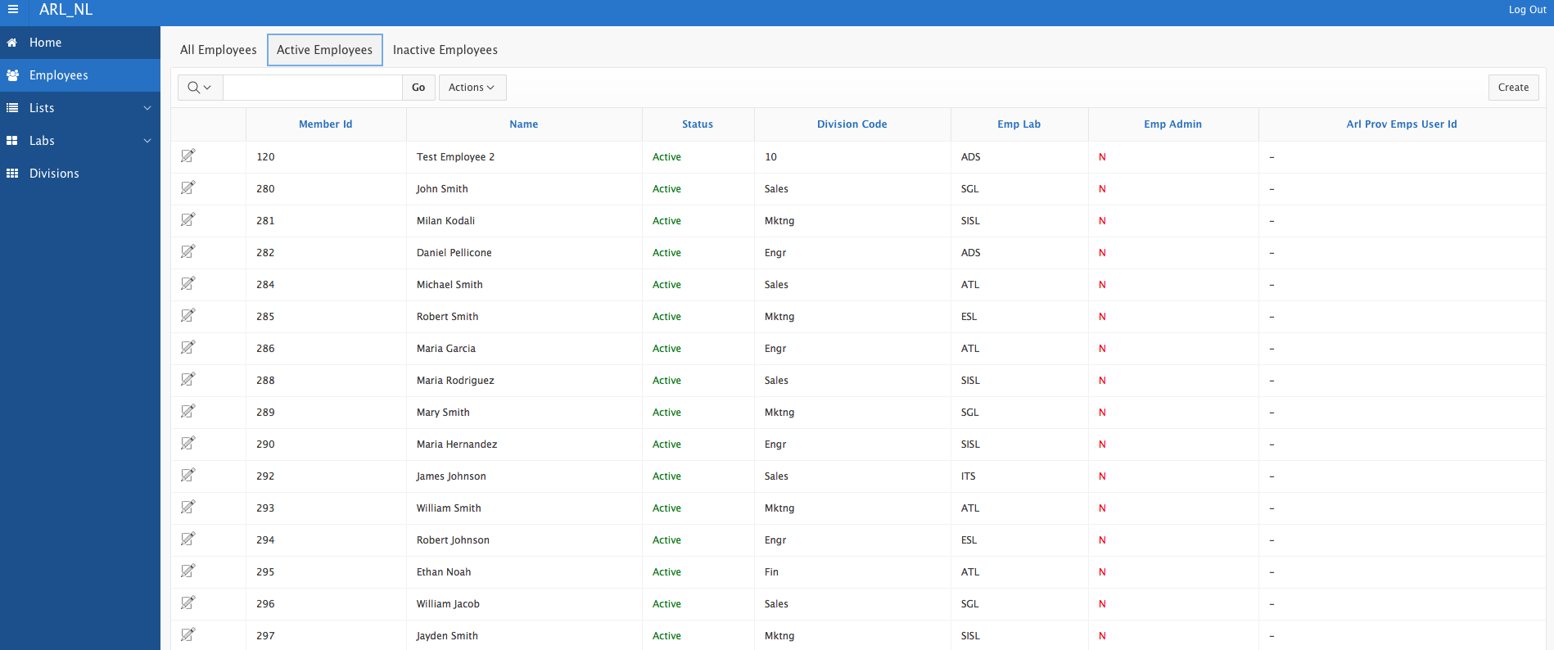
Employees

Slide 7
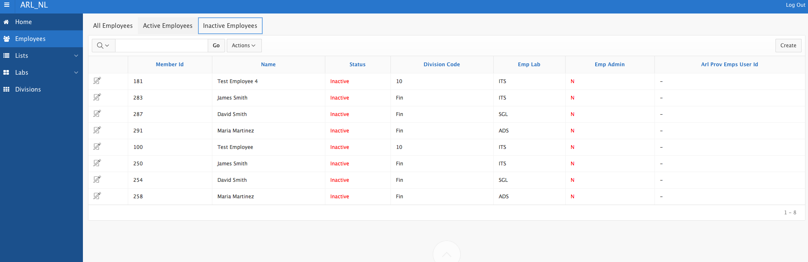
Employees

Slide 8
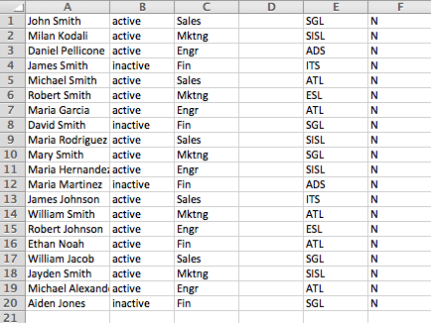
Employee CSV File

Slide 9
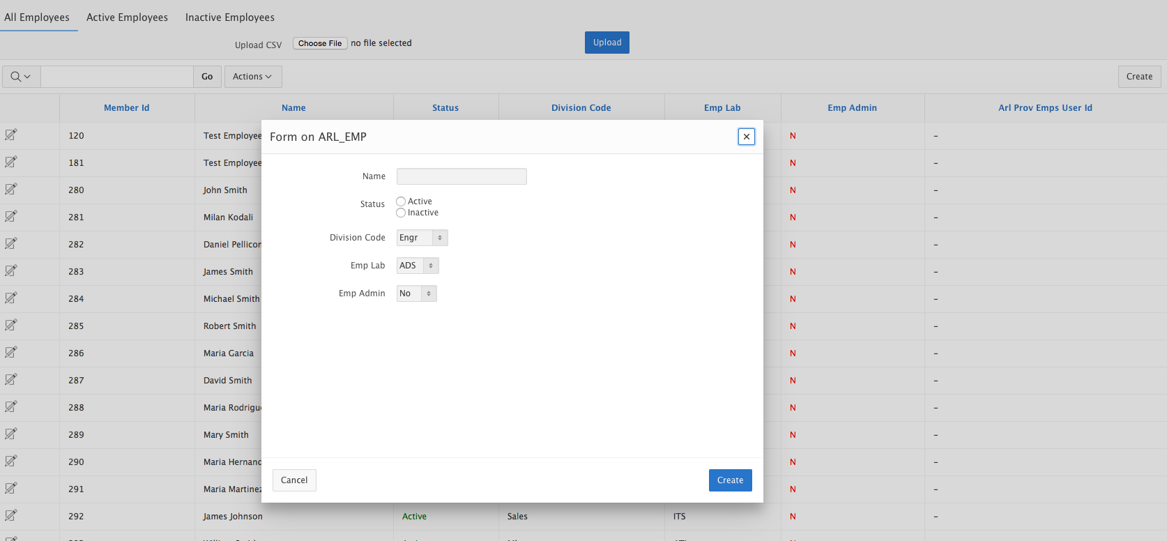
Create/Edit Employee

Slide 10
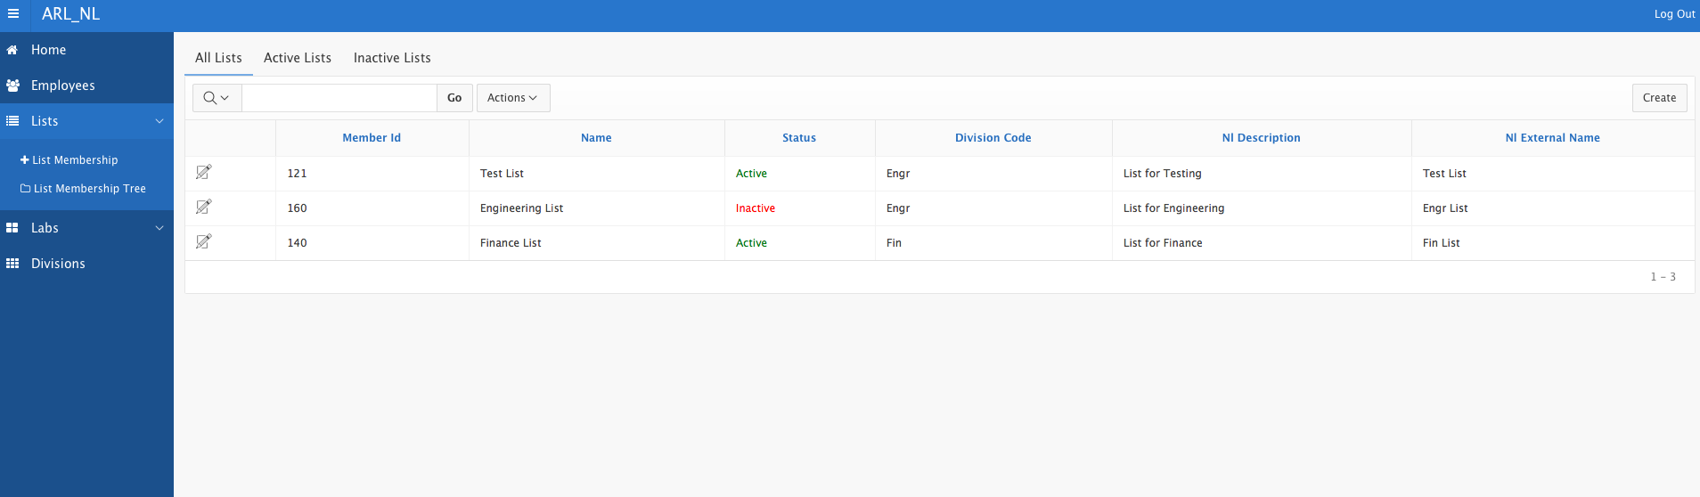
Lists

Slide 11
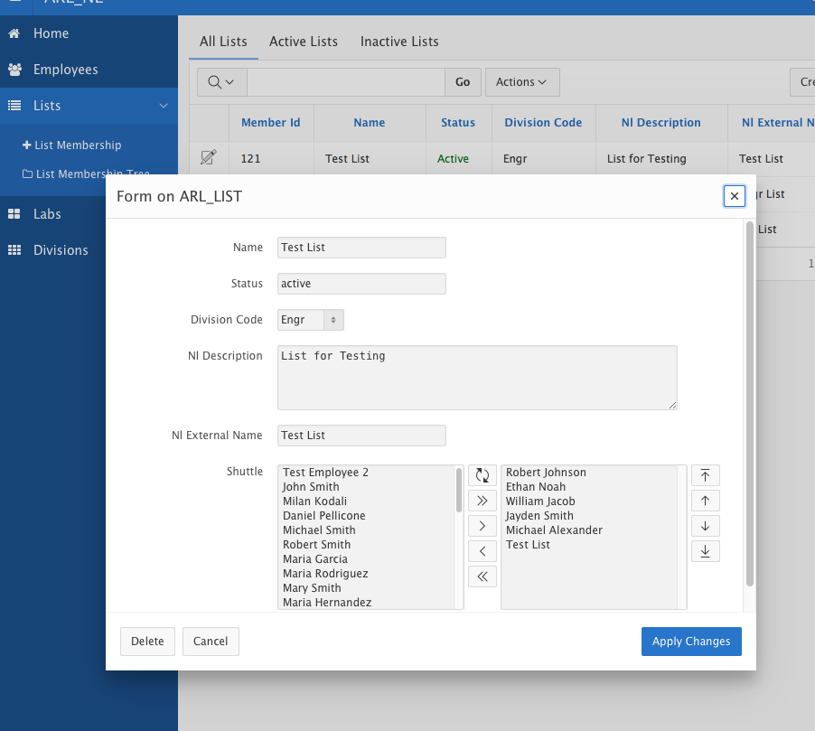
Create/Edit List

Slide 12
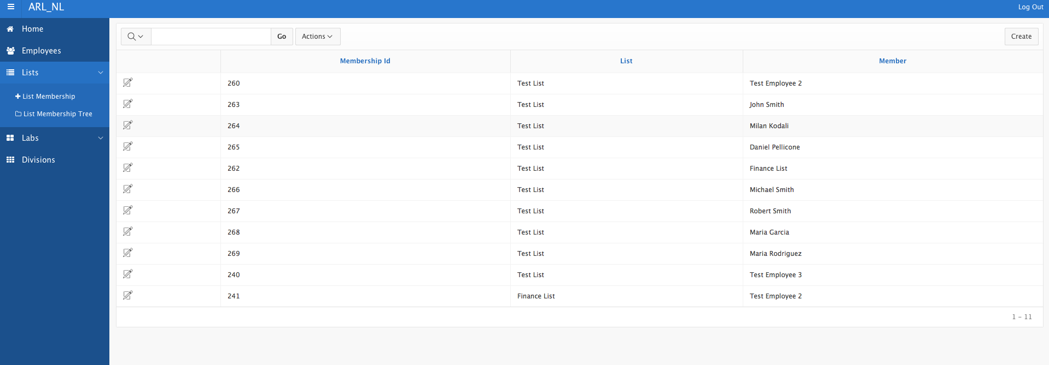
List Membership Table

Slide 13
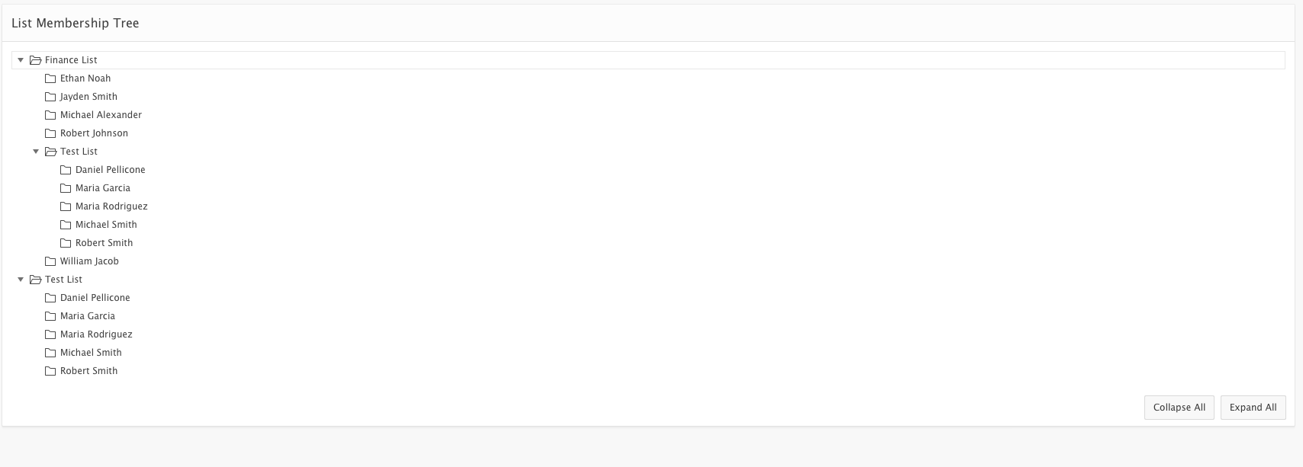
List Membership Tree

Slide 14
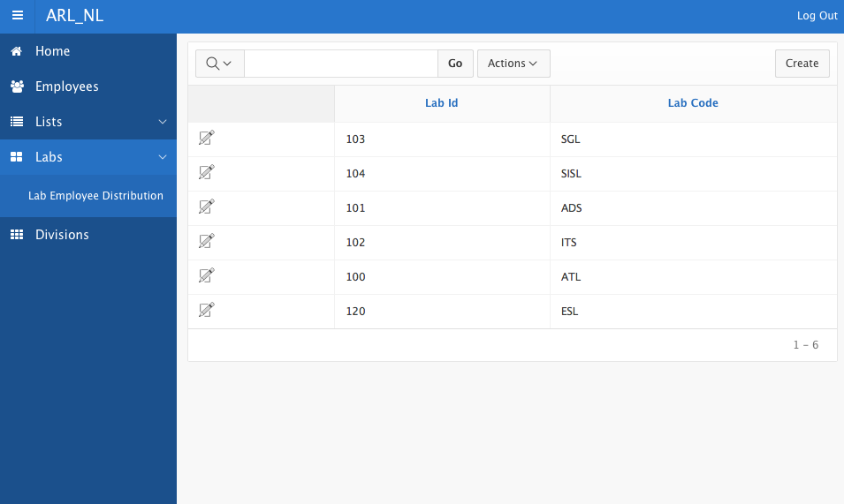
Labs

Slide 15
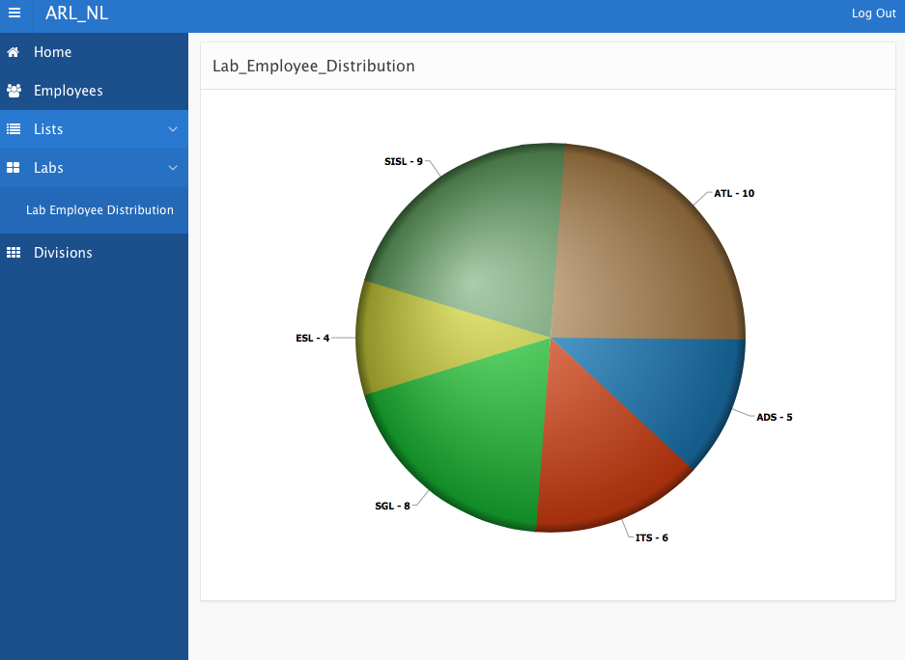
Labs

Slide 16
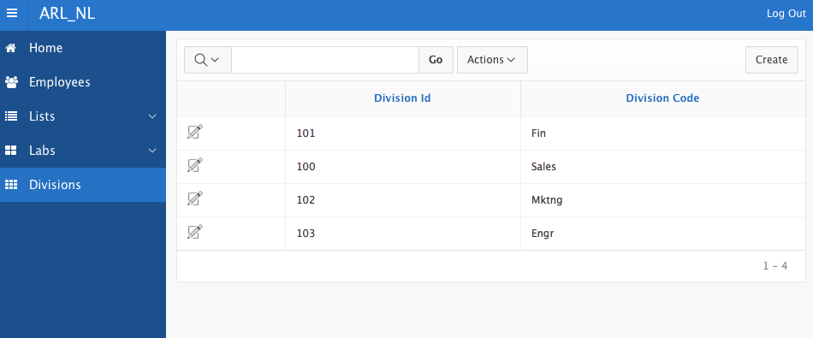
Divisions

Slide 17
Requirements Met
Includes all of the requested tables/columns
Automatically pulls unique numeric identifier for records
More than one member can be added to list at once
Members can be individual employees or other lists
Only active members can be added to lists
Removing an employee also removes the employee from all mailing lists
Can view memberships

Slide 18
Requirements Not Met
Ownership division code should default to user’s ownership division
Admin Privileges
Membership cloning

Slide 19
Must Haves Included
Search Bar
Data Loading
Tree
Region Views
File Download
Shuttle

Slide 20
Must Haves Not Included
Group Select List
Modal dialog return feature

Slide 21
Good to Haves
Custom Look and Feel using CSS
Chart

Slide 22
Application URL
https://apex.oracle.com/pls/apex/f?p=15996:1:129442251894245::NO:::

